Slide 1

8th Grade Math: Pre-Algebra
Unit 9, Lesson 10 Similar Triangles and Dilations in the Real World Volume 2, pg. 111

Slide 2


Benchmark
MA.8.GR.2.4
Solve mathematical and real-world problems involving proportional relationships between similar triangles.
volume 2, pg. 111

Slide 3
Integrated Mathematical Thinking and Reasoning Standards
MA.K12.MTR.1.1 Actively participate in effortful learning both individually and collectively.
MA.K12.MTR.2.1 Demonstrate understanding by representing problems in multiple ways.
MA.K12.MTR.4.1 Engage in discussions that reflect on the mathematical thinking of self and others.
MA.K12.MTR.5.1 Use patterns and structure to help understand and connect mathematical concepts.
MA.K12.MTR.7.1 Apply mathematics to real-world contexts.
volume 2, pg. 111

Slide 4

Learning Target
I can solve real-world problems that involve similar triangles.
volume 2, pg. 111

Slide 5

Warm-Up
volume 2, pg. 111

Slide 6
9.10.1 Warm-Up: Relationships in Triangles
A figure is shown. Side lengths and distances, in units, are labeled using variables and known quantities.
How many right triangles do you see in the figure?
Write at least two equations that relate some of the side lengths or distances marked in the figure.
volume 2, pg. 111

Slide 7

Guided Practice
volume 2, pg. 112

Slide 8

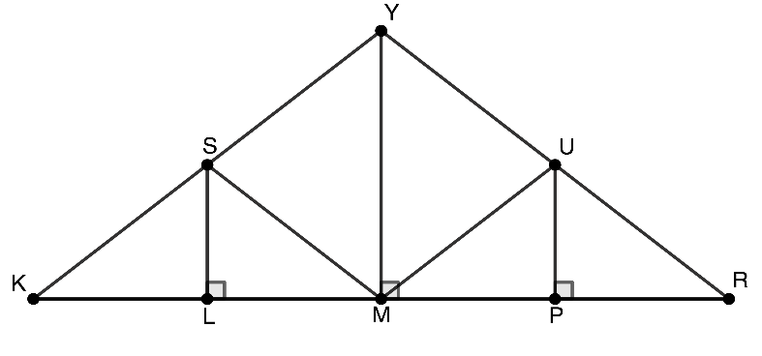
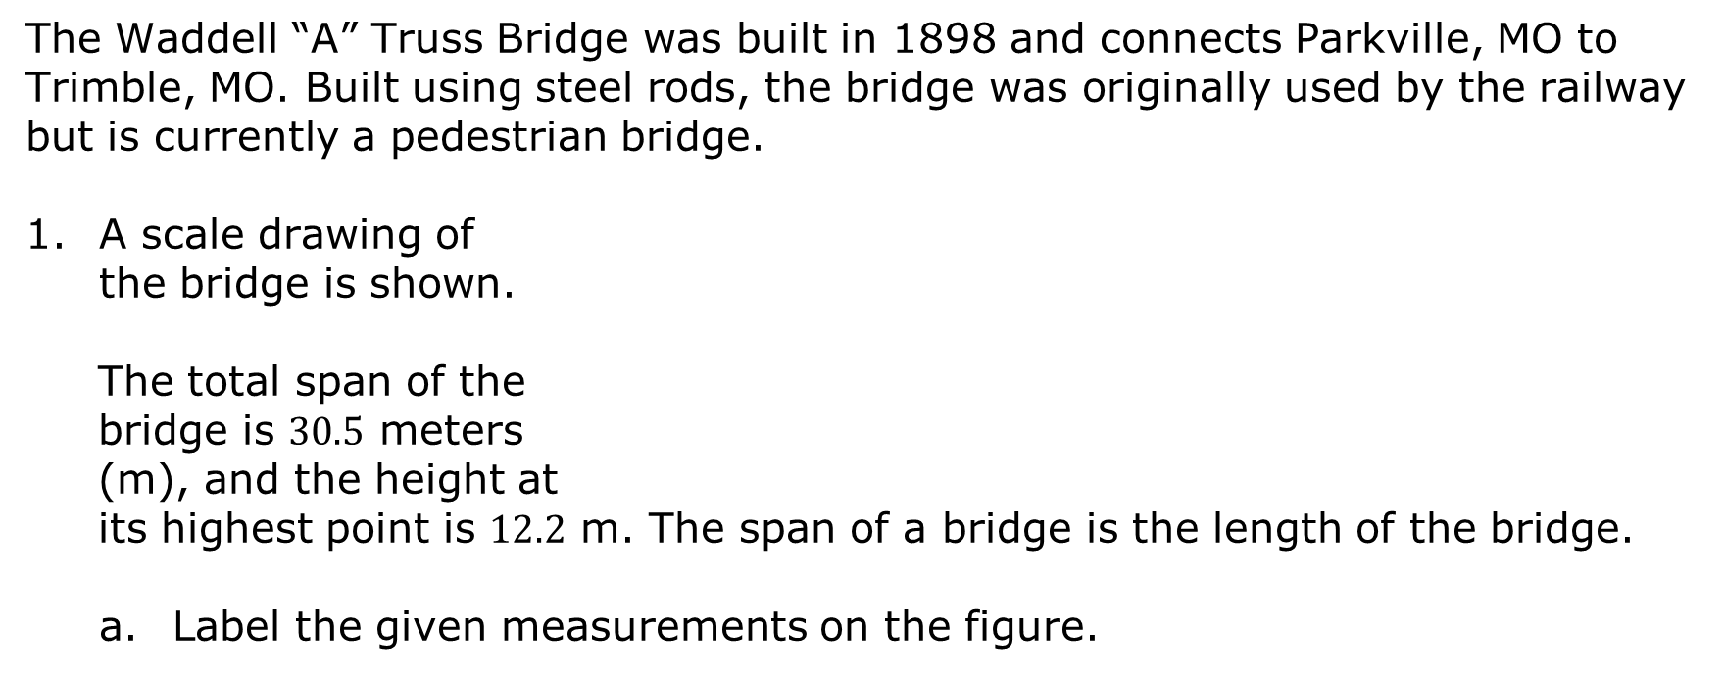
9.10.2 Guided Practice: Dilations and Similar Triangles in the Real World
The Waddell “A” Truss Bridge was built in 1898 and connects Parkville, MO to Trimble, MO. Built using steel rods, the bridge was originally used by the railway but is currently a pedestrian bridge.
A scale drawing of the bridge is shown.
The total span of the bridge is $30.5$ meters (m), and the height at its highest point is $12.2$ m. The span of a bridge is the length of the bridge.
Label the given measurements on the figure.
volume 2, pg. 112

Slide 9
Complete each statement using the given information.
The span of the bridge is represented by line segment _____.
The height of the bridge is represented by line segment _____.
volume 2, pg. 112

Slide 10
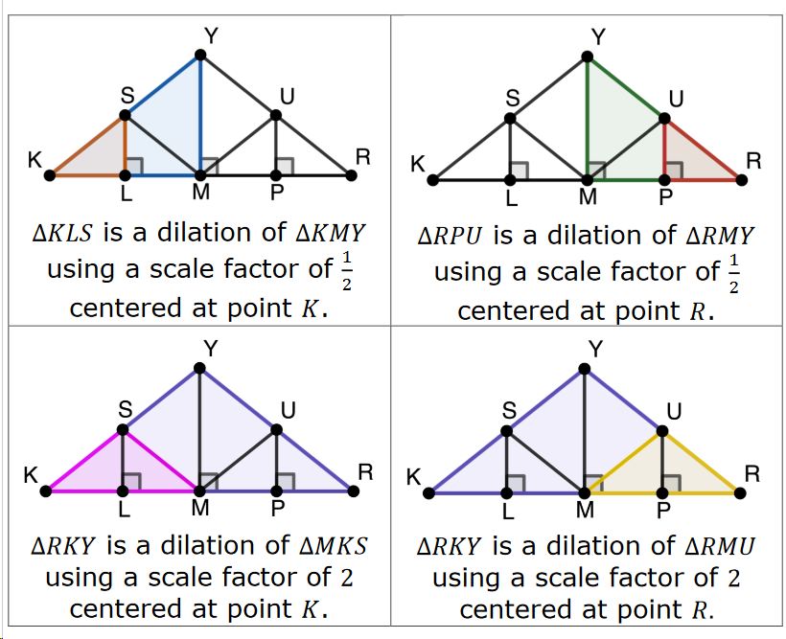
The images and statements below give additional information about the bridge design.
volume 2, pg. 112

Slide 11
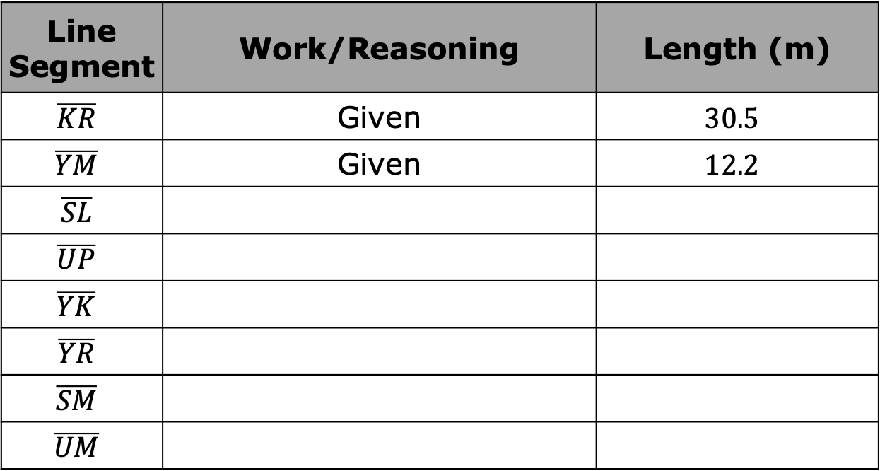
Use the Pythagorean Theorem, properties of similar triangles, and other reasoning to find the lengths of the line segments. Round to the nearest thousandth of a meter.
Line Segment | Work/Reasoning | Length (m)
$$\overline{KR}$$ | Given | $$30.5$$
$$\overline{YM}$$ | Given | $$12.2$$
$$\overline{SL}$$
$$\overline{UP}$$
$$\overline{YK}$$
$$\overline{YR}$$
$$\overline{SM}$$
$$\overline{UM}$$
volume 2, pg. 113

Slide 12
How many total meters of steel were used to create one side of this bridge?
volume 2, pg. 113

Slide 13

Collaboration
volume 2, pg. 113

Slide 14

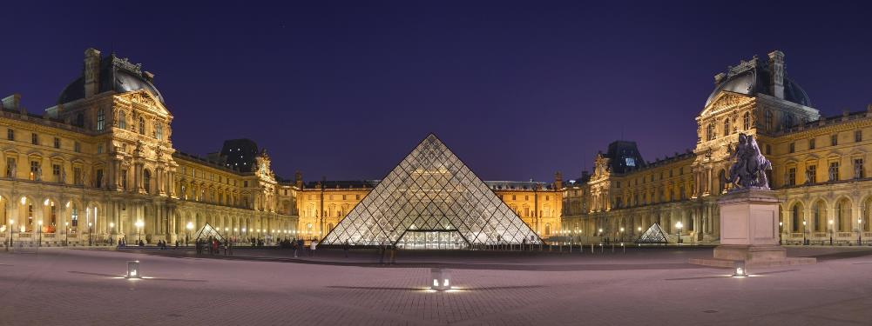
9.10.3 Collaboration: Dilations & Similar Triangles in the Real World
The Louvre in Paris is a famous museum that houses artwork like the Mona Lisa. Though the Louvre building was originally built in 1190 to serve as a fortress, four glass pyramids were built in the courtyard of the Louvre in 1989. These pyramids – one large one in the center, with three smaller ones along the sides – are now the defining structures of the Louvre Museum.
volume 2, pg. 113

Slide 15
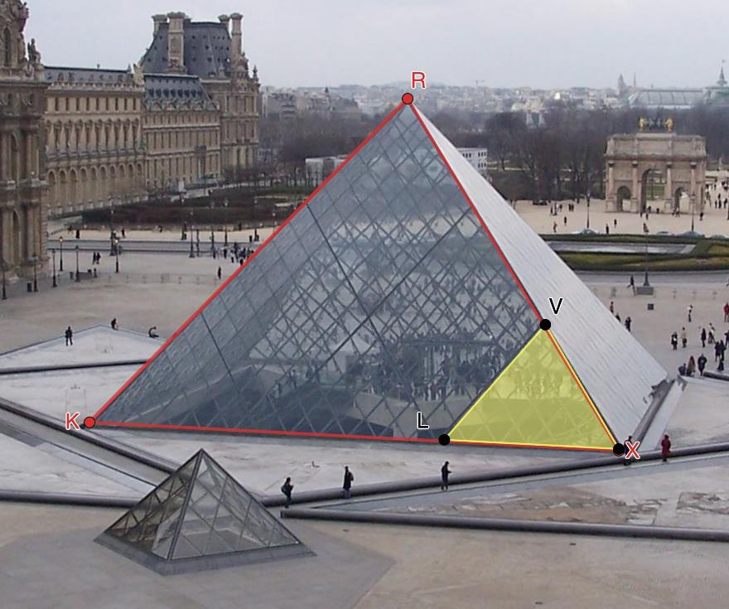
Each panel of the pyramids is built from numerous pieces of glass. The diagram shows $∆RXK$ and $∆VXL$.
volume 2, pg. 113

Slide 16
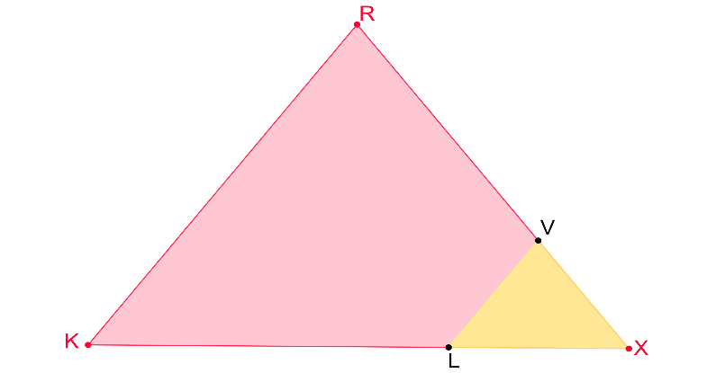

Work with your partner to complete the following.
A scale drawing of one side panel of the large pyramid, $∆RXK$, is shown, including $∆VXL$. $RK=106\frac{1}{2}$ feet (ft) and $LX=37\frac{1}{3}$ ft.
In this design, the full panel, $∆RXK$ can be determined by dilating the piece, $∆VXL$. Explain which point is the center of dilation.
volume 2, pg. 114

Slide 17
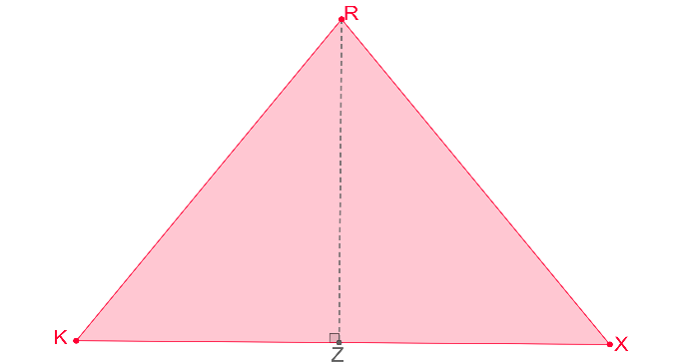
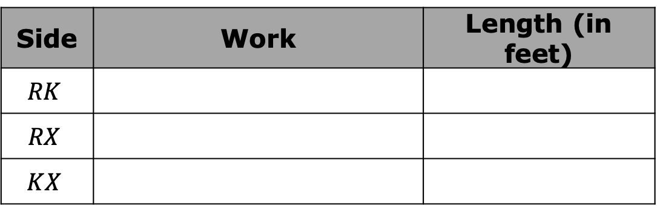

Given the scale factor of dilation is $3$, find the side lengths of the full panel, $∆RXK$.
Label the side lengths of $∆RXK$.
Side | Work | Length (in feet)
$$RK$$
$$RX$$
$$KX$$
volume 2, pg. 114

Slide 18
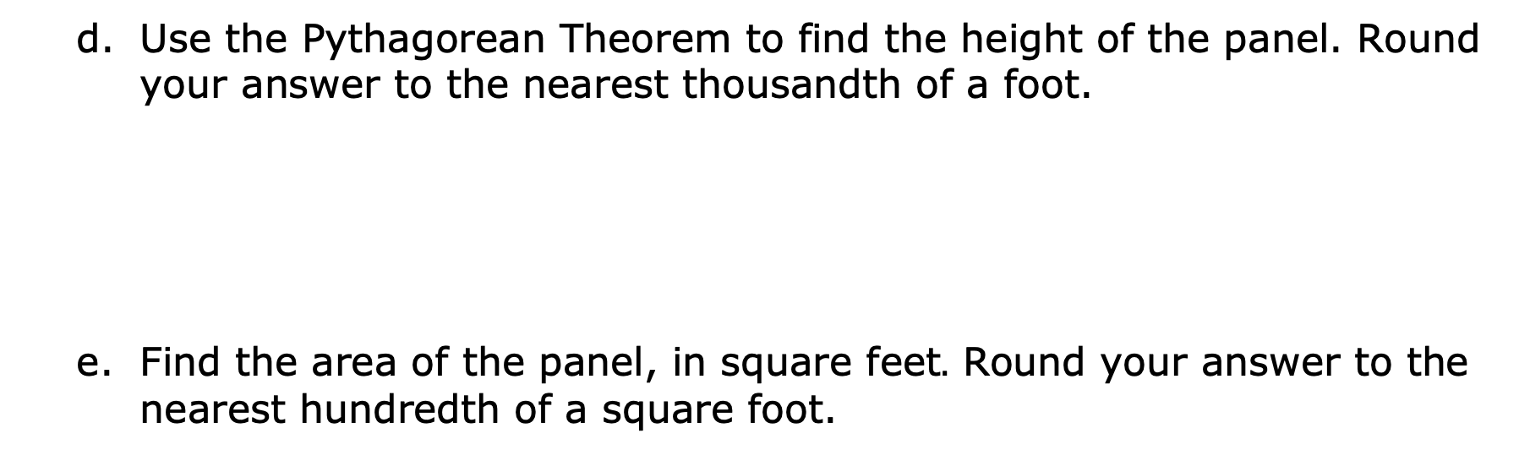
Use the Pythagorean Theorem to find the height of the panel. Round your answer to the nearest thousandth of a foot.
Find the area of the panel, in square feet$.$ Round your answer to the nearest hundredth of a square foot.
volume 2, pg. 114

Slide 19

Wrap-Up
volume 2, pg. 115

Slide 20
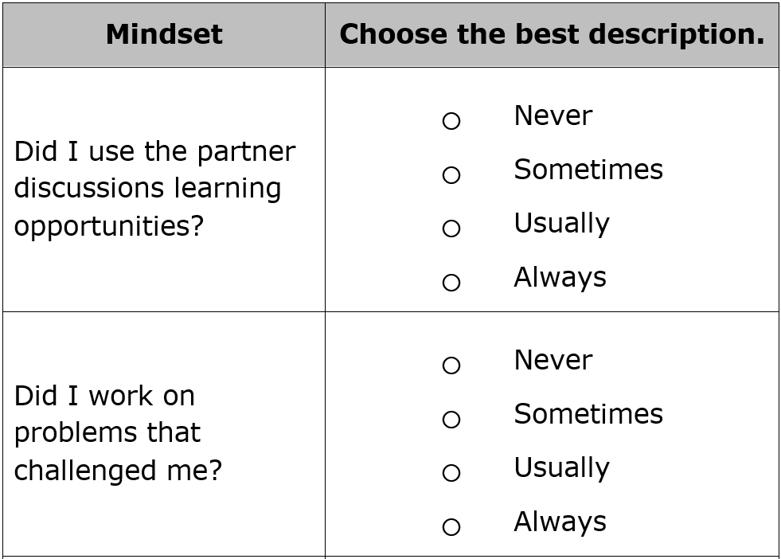
9.10.4 Wrap-Up: Reflection
Complete the table.
volume 2, pg. 115

Slide 21

volume 2, pg. 115

